Slide 1
Customs readiness
For moving goods between Great Britain and Northern Ireland at the end of the transition period
What medical suppliers need to do to prepare for customs changes at the GB-NI border from 1 January 2021
If you have specific questions relating to customs and borders, please direct these to HMRC or post your question on the EU Transition Trader and Industry Community Forum (you will need to register to post a question).
For the latest information on GB-NI customs processes, please see guidance for moving goods from Great Britain to Northern Ireland and for moving goods from Northern Ireland to Great Britain

Slide 2
Contents
Slide | Title | Overview
3 | What are the key changes for medicines and medical products from 1 January 2021 and how can I prepare? | New customs requirements for moving goods between GB and NI from 1 January 2021.
4 | Preparing to move goods from Great Britain to Northern Ireland from 1 January 2021 | Preparatory actions for moving goods from GB to NI.
5 | Using the Trader Support Service to move goods from Great Britain to Northern Ireland | Using the TSS to support you with your customs declarations.
6 | Who is responsible for carrying out customs requirements for moving goods from GB to NI? | Deciding which Incoterms® to use to move your goods.
7 | Submitting customs declarations for goods moving from Great Britain to Northern Ireland from 1 January 2021 | Details of pre-lodgement of customs declarations prior to the movement of goods.
8 | TSS GB-NI declarations process – Customs Freight Simplified Procedures (non-controlled goods) | Process map for submitting declarations when moving goods from GB to NI.
9 | Moving goods from Northern Ireland to Great Britain from 1 January 2021 | The process for moving goods from NI to GB.
10 | Moving goods between NI and the EU, and between NI and the rest of the world | The process for moving goods between NI and the EU or RoW.

Slide 3
What are the key changes from 1 January 2021 for medicines and medical products and how can I prepare?
On 1 January 2021 the Northern Ireland Protocol will come into force.
This means there will be changes to the way goods move between Great Britain and Northern Ireland, including new checks and controls. The Government has committed to providing Northern Irish businesses unfettered access when trading with the rest of the UK market, ensuring no new barriers to trade.
You will need to make declarations, including digital import declarations and digital safety and security declarations, for goods moving from Great Britain to Northern Ireland.
You should act now to get your business ready for these changes. If you are not ready, you may not be able to move goods between Great Britain and Northern Ireland from 1 January 2021.
To streamline processes as far as possible, the Government has set up a new Trader Support Service (TSS) to support traders with their customs declarations.
These new customs requirements are in addition to regulatory requirements that you may also need to follow from January 2021, such as:
Guidance on regulating medical devices from 1 January 2021.
Guidance on actions to take for sourcing medicines in different circumstances.
Guidance for UK wholesalers and manufacturers on how to import human medicines including unlicensed medicines, how to apply for a licence and how much it costs.
Further guidance on the phased implementation of Falsified Medicines Directive and regulatory importation requirements in respect to Northern Ireland up to 31 December 2021 is available here.

Slide 4
Preparing to move goods from Great Britain to Northern Ireland from 1 January 2021
What traders should do now to prepare
Get a GB EORI number if you don’t already have one. Register for one here.
Sign up to the free Trader Support Service (TSS).
Get an XI EORI number:
To get an EORI number that starts with XI, you must already have an EORI number that starts with GB.
You will automatically be given an XI EORI number if you register with the TSS and you already have a GB EORI number.
You can also apply for an XI EORI number directly here.
Review guidance and materials in the free NI Customs & Trade Academy.
Familiarise yourself with Incoterms®.
Make sure all partners in your supply chain are also signed up to the TSS.
Check if additional licences or authorisations are required if you are moving controlled goods. The majority of medicines and medical products are non-controlled goods. Find out if your good is on the controlled goods list here.
Tariffs
There will be no tariffs on trade between Great Britain and Northern Ireland, with the exception of goods that are ‘at risk’ of entering Ireland or the EU Single Market.
Further information on which goods are classed as ‘at risk’ is expected from the EU shortly.
VAT
Northern Ireland is, and remains, part of the UK’s VAT system.
VAT will continue to be accounted as it is currently on goods sold between Great Britain and Northern Ireland. This means that the seller of the goods will continue to charge its customers VAT and should show this on its invoices.
Check which procedures apply to you here.

Slide 5
Using the Trader Support Service to move goods from Great Britain to Northern Ireland
What is the Trader Support Service (TSS)?
The TSS will support traders in handling customs declarations processes. The TSS:
will help if you move goods between Great Britain and Northern Ireland, or bring goods into Northern Ireland from outside the UK
is free to use and will guide you through any changes to the way goods move between Great Britain and Northern Ireland
can complete declarations on your behalf
will automatically register you for an XI EORI number (a specific EORI number that you need for moving goods into or out of NI)
Traders using the TSS from 1st January 2021
Traders will be supported to understand the information they will need to collect about their goods, such as their description, value and any supporting documentation required.
The service will then use this information to complete import and safety and security declarations on behalf of traders.
Where a trader uses the TSS to complete these they will not need to access HMRC systems, such as the Customs Declaration Service (CDS) or the Import Control System (ICS), themselves.
Traders who prefer to manage the customs declarations themselves
If you choose not to use the TSS, you, or your customs agent, will need to:
Ensure you can access to the appropriate HMRC systems in order to submit customs declarations. There are facilitations available to make the declarations processes easier.
Check what customs declarations will be required to move your goods, such as:
How to raise a digital Entry Summary (ENS) declarations (also referred to as Safety & Security declarations) into the ICS. The haulier or ferry operator is usually responsible for submitting the declaration.
Supplementary declarations, Simplified Frontier declarations and full import declarations.

Slide 6
Who is responsible for carrying out customs requirements for moving goods from GB to NI?
Senders and receivers need to agree on how the goods will be moved. This means you will need to agree the terms for:
who arranges and pays for the freight
who insures the goods in transit
who is responsible for making the import declaration when the goods enter NI and who pays any tariffs applicable
These terms are set out under ‘Incoterms®’ (International Commercial Terms), which define the responsibilities of senders and receivers and denote who has ownership of the transport journey. Further information can be found here.
There are 11 different Incoterms®. The Incoterms® that will most likely be used for GB-NI trade from 1 January will be Ex Works (EXW) and Delivered Duty Paid (DDP). It is the responsibility of the sender (supplier) and receiver (buyer) of the goods to agree which Incoterm® will be used.
If operating under Delivered Duty Paid terms, the GB supplier/sender is responsible for arranging the transport, submitting the declarations, and for paying duty (if the goods are determined to be ‘at risk’). A sender or receiver can also ask a freight forwarder, haulier or customs agent to complete these steps on their behalf.
Under Ex Works terms, the NI receiver/buyer is responsible for arranging the transport, submitting the declarations and paying the duty (if applicable).
Under Delivered at Place (DAP) terms, the GB supplier is responsibility for arranging the transport, but the NI buyer is responsible for making the declarations.
Different Incoterms® may be more appropriate in different circumstances. For example:
If a large GB supplier is supplying a small NI buyer, DDP may be more suitable.
If a large NI business is receiving goods from a small GB supplier, EXW may be more suitable.
This is because the larger company may have access to cheaper transport or more experience of declarations processes.
If SMEs are trading with each other, the SMEs will need to agree which terms to use. In these cases, a freight forwarder or carrier can assist based on the agreed Incoterm®.

Slide 7
Submitting customs declarations for goods moving from Great Britain to Northern Ireland from 1 January 2021
There will be new processes that you will need to follow when moving goods after 1 January 2021.
All Irish Sea movements from Great Britain to Northern Ireland will move under a pre-lodgement model.
This means that all goods must have completed an ENS (Entry Summary, or Safety & Security) declaration before the goods can be shipped from Great Britain to Northern Ireland.
TSS will support registered businesses by raising ENS declarations into the ICS system on their behalf, free of charge
The Haulier or Ferry Operator is usually responsible for ensuring the declaration is submitted.
The trader will need to provide a Movement Reference Number (MRN) – a unique reference number for each consignment carried – which proves that a declaration has been pre-lodged.
The MRN is provided to the haulier so that they can complete an entry into the Goods Vehicle Movement System (GVMS) and generate a Goods Movement Reference (GMR) before arriving at the departure port. The GMR will be required in order to board the ferry.
More information on GVMS will be available in due course.

Slide 8
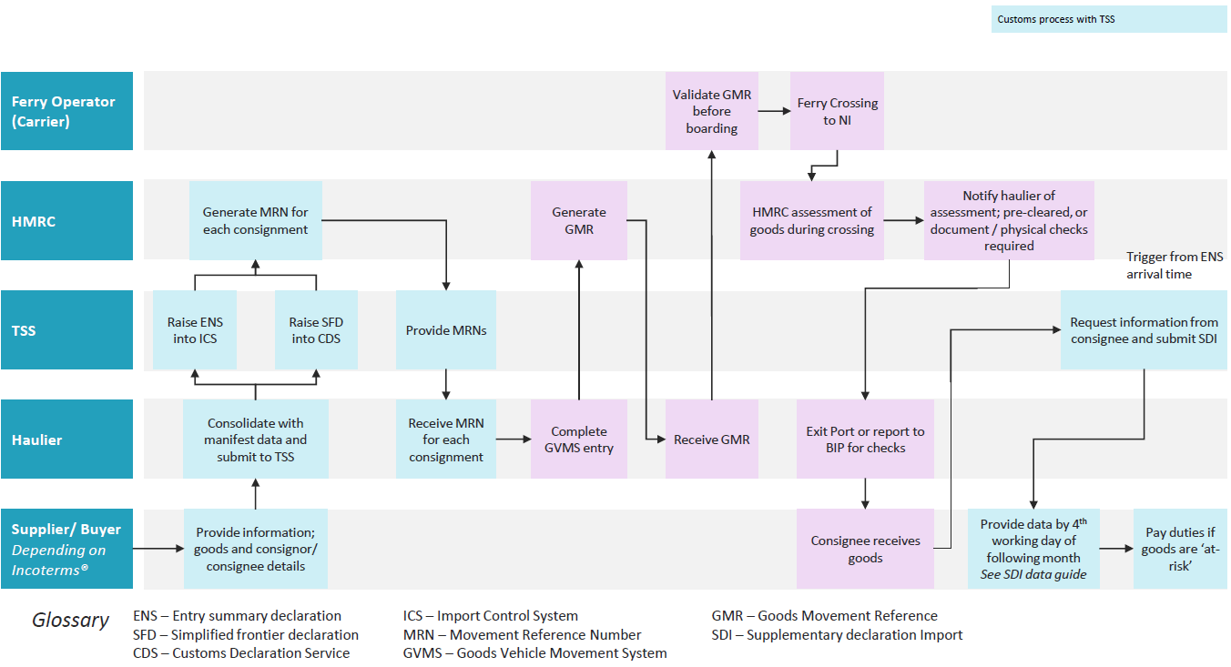
TSS GB-NI declarations process – Customs Freight Simplified Procedures (non-controlled goods)

Slide 9
Moving goods from Northern Ireland to Great Britain from 1 January 2021
The UK Government will guarantee unfettered access for Northern Ireland’s businesses. This means that trade for these businesses will continue as it does now.
There will be no additional processes, paperwork or restrictions on Northern Ireland goods moving to Great Britain. This includes:
no import customs declarations as goods enter the rest of the UK from Northern Ireland;
no entry summary (‘safety and security’) declaration as goods enter the rest of the UK from Northern Ireland;
no tariffs applied to Northern Ireland goods entering the rest of the UK in any circumstances;
no customs checks;
no new regulatory checks;
no additional approvals required for placing goods on the market in the rest of the UK; and,
no export or exit summary declarations for the majority of goods.
This will apply only to Northern Ireland businesses (including businesses headquartered in Great Britain with operations in Northern Ireland). More information on the qualifying status for NI businesses is expected shortly.
There are some limited exceptions to this, which are outlined here. The TSS will able to provide support to traders in these circumstances.
A limited list of goods will require export declarations when moving from Northern Ireland to Great Britain, such as:
Goods moving under customs duty suspension; and
Goods moving under transit.
Businesses in Ireland will need to follow the normal process for importing goods into Great Britain, including submitting customs declarations and paying any tariff duties that are due.
There are requirements when sourcing medicines for wholesale purposes from Northern Ireland under the unfettered access route, which are outlined here.

Slide 10
Moving goods between NI and the EU, and between NI and the rest of the world
Moving goods between NI and the EU
There will be no change for the direct movement of goods covered by the Protocol between Northern Ireland and EU Member States, including Ireland.
Trade in goods between Northern Ireland and Ireland, and between Northern Ireland and EU Member States, will continue unaffected, with no change at the border, no new paperwork, and no tariffs or regulatory checks.
However, if you move goods from Northern Ireland to the EU via Great Britain, there will be new requirements.
Any approvals or certifications secured in order to place goods on the market in the EU will be recognised when seeking to place the same goods on the market in the United Kingdom – avoiding the need for additional approvals to access the UK market.
This will also apply to goods moved under transit between Northern Ireland and the EU via Great Britain (‘the landbridge’). If you are using transit:
You must be authorised to use transit and movements must start and end at an approved premises or a government office of departure/destination
Your goods will be subject to specific processes and declarations
You will only need to make customs declarations and pay import duties when the goods arrive at their final destination
For EU-GB-NI transit movements, no export declaration is required for the goods to leave the EU and no import declaration is needed in NI, as the goods move under duty suspension and remain in the Single Market. However, you will still need to make entry and exit Safety & Security declarations.
Moving goods between NI and RoW
The overall process for trading between Northern Ireland and non-EU countries will continue broadly as it does today.
Further guidance is available here:
Export goods to countries outside the EU: step by step
Import goods from outside the EU: step by step
Tariffs may apply for goods imported from the rest of the world.
Further information is available here.

